Slide 1
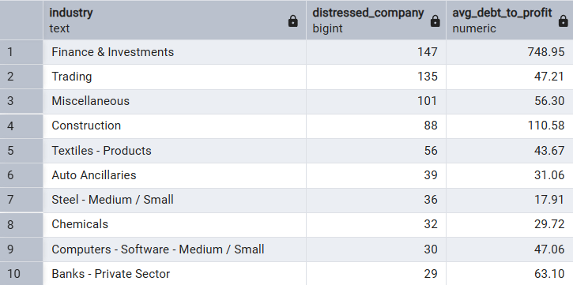
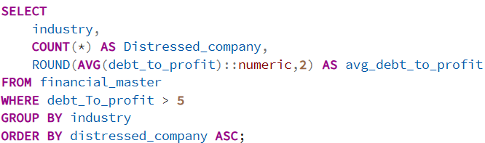
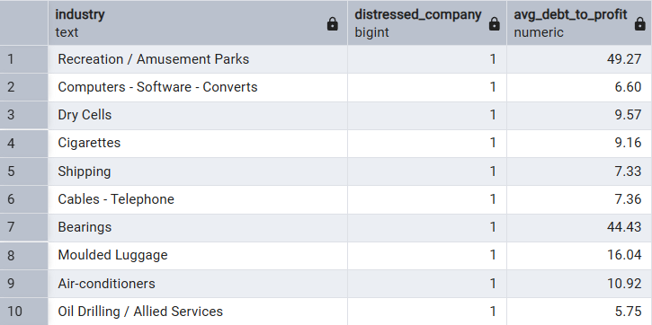
DEBT & FINANCIAL HEALTH
Question 12: Identify companies with Debt-to-Profit ratio above 5x — how concentrated is the risk and which sectors are most exposed?
Output
Query
Observation:
• Finance & Investments has the highest concentration of distressed companies with elevated debt burden. • Trading and Construction also show meaningful exposure to high debt levels. • Debt stress appears concentrated in a few sectors rather than evenly distributed.
Recommendation:
• Prioritize companies with improving profitability and debt reduction trends. • Monitor cash flow coverage alongside debt metrics. • Review sector-level leverage sustainability before investment decisions.
Insight:
• High Debt-to-Profit indicates lower financial flexibility and greater earnings pressure. • Sector concentration suggests dependence on leverage or weaker cash generation. • Persistent high leverage may increase refinancing and solvency risk.

Slide 2
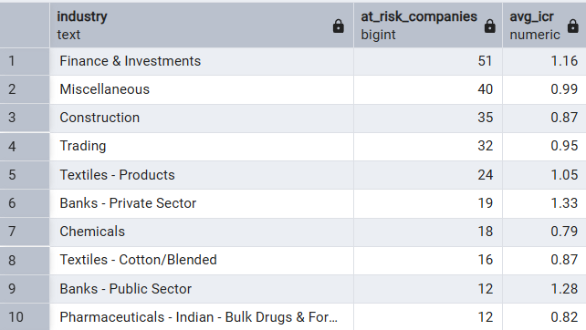
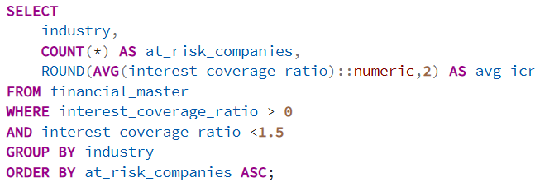
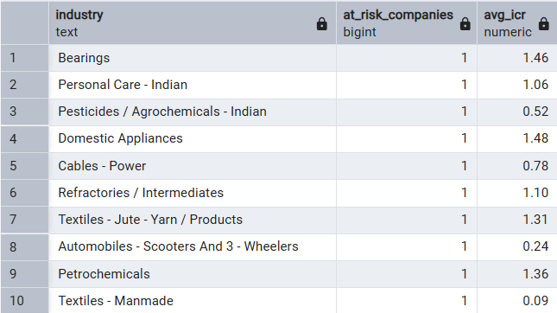
Question 13: Identify companies with Interest Coverage Ratio below 1.5x — where repayment risk is highest?
Output
Query
Observation:
• Finance & Investments reports the largest number of companies with weak interest coverage. • Construction and Trading also appear among higher-risk sectors. • Several sectors show average coverage close to or below 1x.
Recommendation:
• Focus on EBITDA recovery and interest servicing trends. • Avoid relying only on earnings growth without debt improvement. • Track coverage movement across multiple periods.
Insight:
• Low interest coverage indicates earnings are insufficient to comfortably service debt. • Sustained pressure may lead to refinancing dependence or profitability erosion. • This metric signals elevated financial stress rather than immediate default

Slide 3
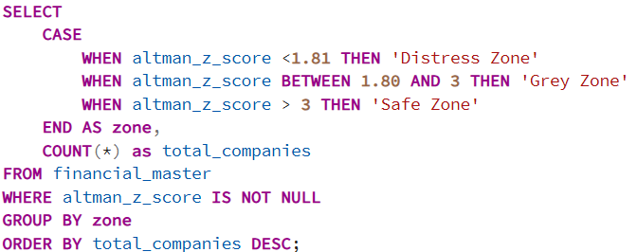
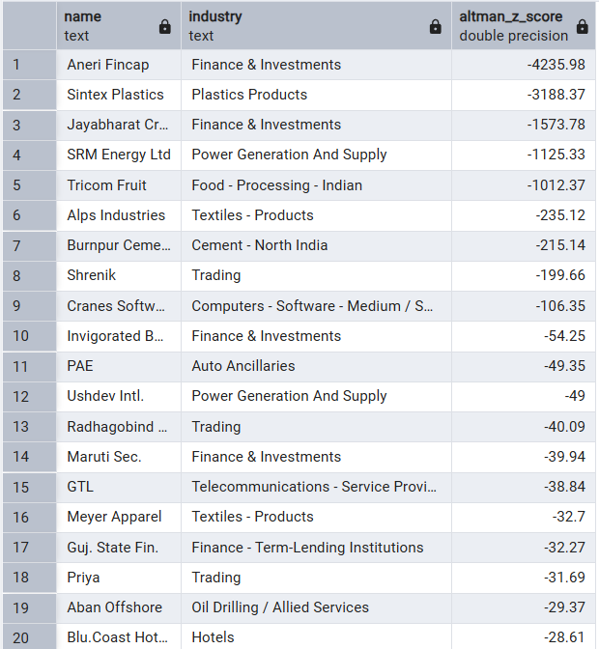
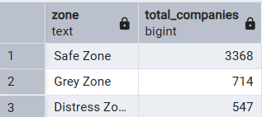
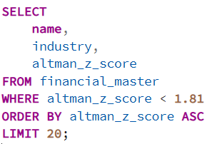
Question 14: What is the Altman Z-Score distribution and how many companies fall into the Distress Zone (Z < 1.81)?
Query
Output
Query
Output
Observation:
• Most companies remain in the Safe Zone, while a smaller but meaningful group falls into Distress Zone. • Distressed companies are spread across multiple industries rather than one sector. • The distribution indicates overall stability with selective pockets of financial risk.
Recommendation:
• Prioritize monitoring companies near or inside the Distress Zone. • Combine Z-score with cash flow and debt analysis. • Use trend analysis instead of one-time screening.
Insight:
• Companies in Distress Zone may face higher bankruptcy or restructuring risk. • Broad sector representation suggests company-level financial discipline matters more than industry effect. • Lower Z-scores often reflect combined pressure from leverage, liquidity, and profitability.

Slide 4
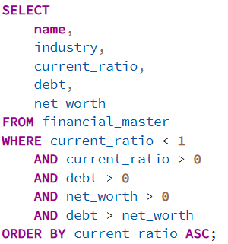
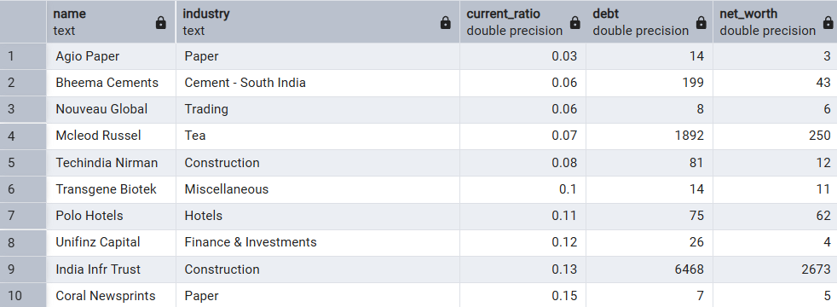
Question 15: Identify companies with Current Ratio below 1 and high debt — which names show liquidity stress?
Query
Output
Recommendation:
• Review short-term obligations and cash conversion cycles. • Monitor debt restructuring and liquidity improvement initiatives. • Treat these companies as higher-risk until working capital stabilizes.
Observation:
• Selected companies show both weak short-term liquidity and elevated debt levels. • Construction, Paper, Hotels, and Finance-related sectors appear in the risk list. • Some firms display extremely low current ratios, indicating working capital pressure
Insight:
• Low liquidity combined with leverage increases refinancing and operational risk. • Companies may depend heavily on external funding to maintain operations. • This profile often signals weaker financial resilience during downturns.

